Slide 1
Module 2 Statistics and Data Visualization

Slide 2
Content
Statistical measures
Mean
Median
Mode
Variance and standard deviation
Correlation and covariance
Data visualization tools
Power BI
Visualization with Pandas

Slide 3
Statistical measures

Slide 4
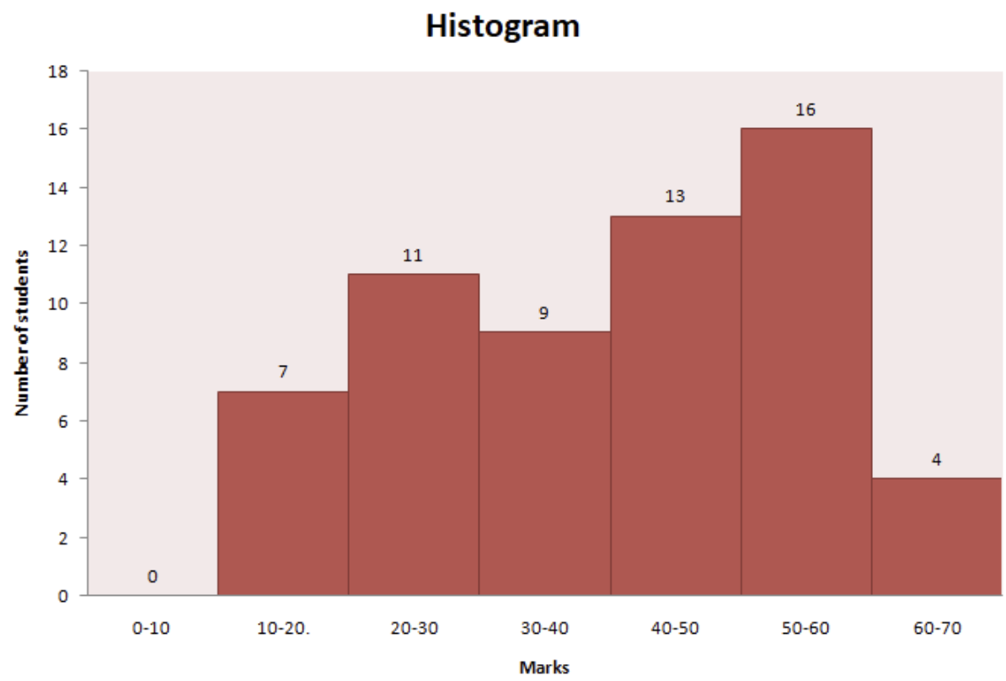
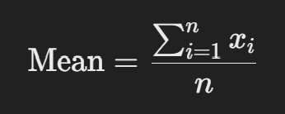

Mean
The mean is the sum of all data points divided by the number of data points.
Formula
Use in Data Science:
The mean gives a central value for the dataset, often used to understand the general trend of the data.
Example: If you're analyzing the monthly income of a group of people, the mean would tell you the average income.
Limitation: The mean is sensitive to outliers (extremely high or low values), which can distort the result.

Slide 5
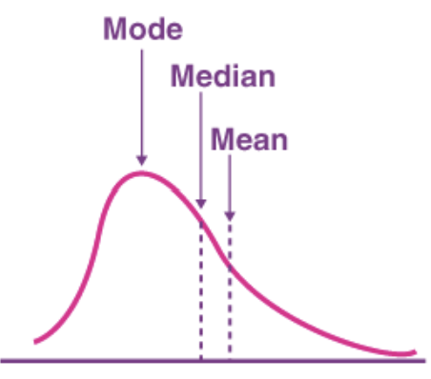
Median
The median is the middle value when a dataset is ordered from lowest to highest. If the dataset has an even number of values, the median is the average of the two middle numbers.
Steps to Calculate
Sort the data.
If nnn is odd, median = middle value
If nnn is even, median = average of the two middle values.
Use in Data Science
The median is useful when you have skewed data (data with outliers). It gives a better idea of the central tendency when the mean is not reliable
Example: If you're analyzing home prices in a city, and there are a few very expensive homes, the median will give a better sense of typical home prices than the mean
Advantage: The median is resistant to outliers, unlike the mean

Slide 6
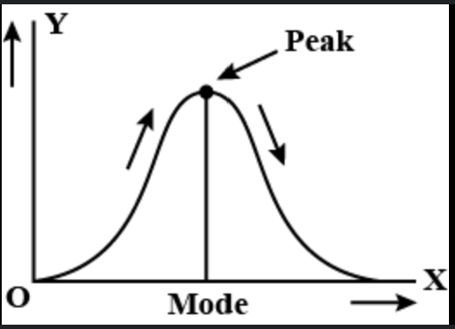
Mode
The mode is the value that occurs most frequently in a dataset.
Example: In the dataset {1, 2, 2, 3, 4}, the mode is 2 because it appears twice, more than any other number.
Use in Data Science
The mode is useful when you want to know which value is the most common in categorical data or when analyzing repeated behaviors in the data.
Example: In customer feedback, if the rating "4" is the most frequent, that would be the mode.
Limitation: Some datasets may have no mode (if no value repeats) or multiple modes (if more than one value is equally frequent).

Slide 7
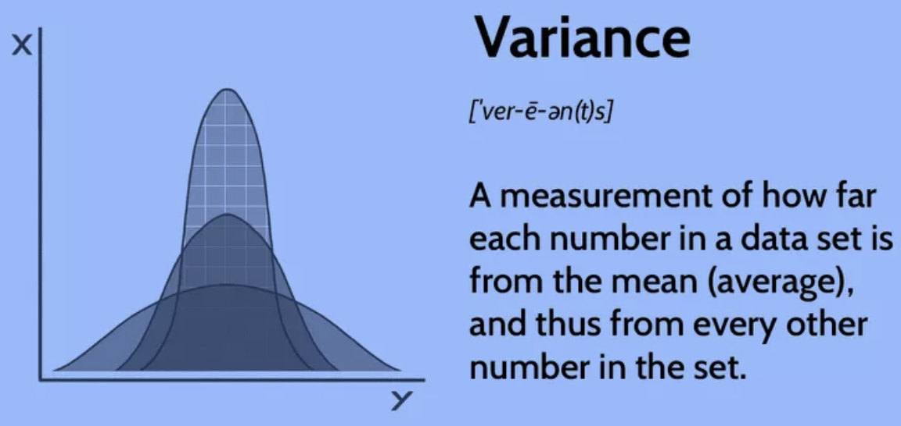
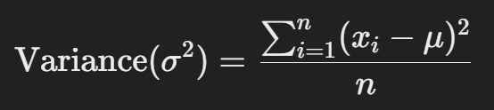
Variance
Variance measures the spread or dispersion of data points
from the mean. It tells us how much the data varies.
Formula:
Use in Data Science
Variance helps you understand how spread out the data is. A high variance means the data points are very different from each other, while a low variance means they are close to each other.
Example: If you're analyzing the heights of people in two different cities, variance will tell you whether the heights are generally similar or very different within each city.
Limitation: Since the formula squares the differences, the result is in squared units, which may not be intuitive (e.g., if you're measuring height, variance will be in "square centimeters").

Slide 8
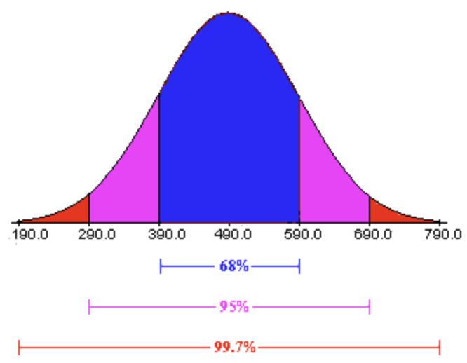
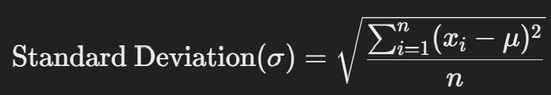

Standard Deviation
Standard deviation is the square root of the variance. It provides a measure of spread in the same units as the original data.
Formula:
Use in Data Science:
Standard deviation is more interpretable because it's in the same units as the data. It tells you how much, on average, the data points deviate from the mean.
Example: If the standard deviation of exam scores is 5, it means that most students' scores are within 5 points above or below the average score.
Key Point: In a normal distribution (bell curve), about 68% of the data lies within 1 standard deviation from the mean, and about 95% lies within 2 standard deviations.

Slide 9
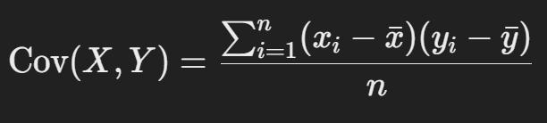
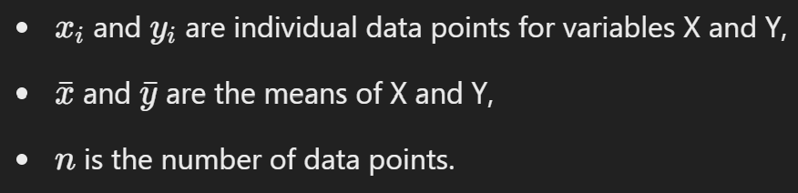
Covariance
Covariance is a measure of how two variables change together. If one variable increases while the other also increases, the covariance is positive. If one increases while the other decreases, the covariance is negative. If there's no consistent pattern, the covariance is zero or close to zero.
Formula:

Slide 10
Interpretation
Positive covariance: The two variables increase together.
Negative covariance: As one variable increases, the other decreases.
Zero (or close to zero): There's no linear relationship between the variables.
Example:
Let’s say you’re analyzing the amount of time a student studies (X) and their exam score (Y). If both tend to increase together, the covariance will be positive, meaning there’s a direct relationship between study time and performance.
Limitation: Covariance gives us the direction of the relationship (positive or negative) but doesn’t tell us the strength of the relationship. Also, the units of covariance depend on the units of X and Y, which makes it difficult to compare across different datasets.

Slide 11
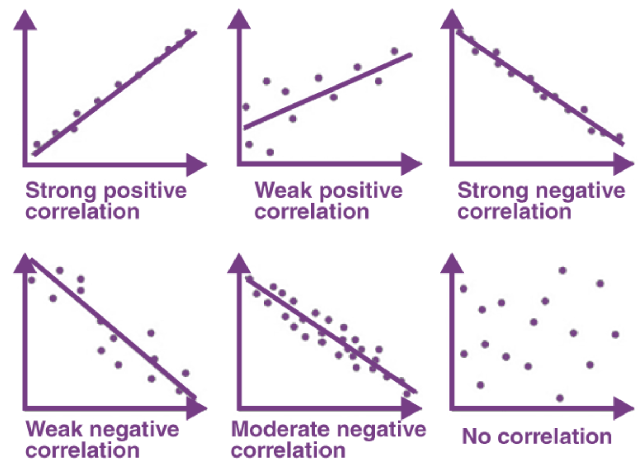
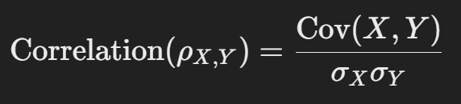
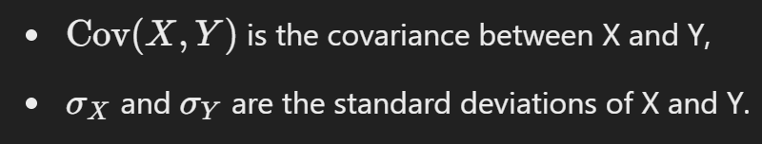
Correlation
Correlation measures both the strength and direction of the linear relationship between two variables, but unlike covariance, it is standardized, meaning it has no units. Correlation is always between -1 and 1.
Formula

Slide 12
Interpretation:
+1: Perfect positive correlation (if X increases, Y always increases in a perfectly linear manner).
-1: Perfect negative correlation (if X increases, Y always decreases in a perfectly linear manner).
0: No linear relationship between X and Y.
Example:
If you're analyzing the relationship between temperature and ice cream sales, and you find a correlation of +0.9, it means there's a strong positive relationship: as temperature rises, ice cream sales increase.
Advantages
Standardized: Correlation gives you a clearer idea of how strongly two variables are related, without the confusion of units.
Easy to Interpret: Correlation values between -1 and 1 make it easier to compare relationships across different datasets.

Slide 13
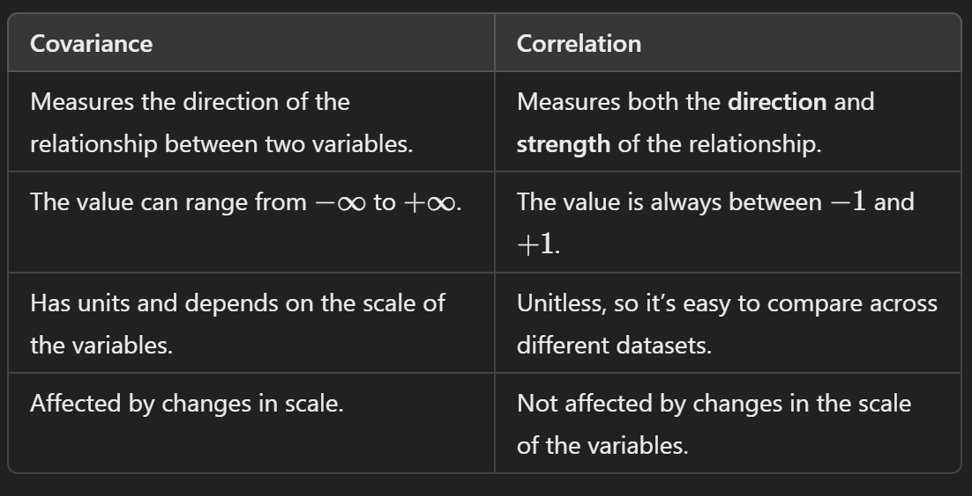
Key differences between Covariance and Correlation

Slide 14
Use in Data Science
Covariance: Covariance is useful when you just want to know whether two variables move together or in opposite directions. However, its units make it harder to interpret in practice.
Correlation: Correlation is used much more often in data science because it not only tells us the direction of the relationship but also the strength, and it’s easy to interpret.

Slide 15
Example in Practice
Let’s say you’re working with a dataset of houses and you want to know if there’s a relationship between the size of the house (in square feet) and its price.
Covariance would tell you whether the house size and price tend to move in the same direction (positive covariance) or in opposite directions (negative covariance). However, you might get a large number with units like “dollars * square feet,” which doesn’t directly tell you much about the strength of the relationship.
Correlation would tell you not only that larger houses tend to be more expensive (positive correlation) but also how strong that relationship is (e.g., a correlation of +0.85 would indicate a strong positive relationship).

Slide 16
Summary
Mean: Average of the data
Median: Middle value of sorted data, good for skewed data
Mode: Most frequent value, useful for categorical data.
Variance: Measures the spread of data, shows how much the data varies from the mean.
Standard Deviation: Square root of variance, shows how much the data deviates from the mean in the same units.
In data science, understanding these measures is crucial for summarizing and interpreting datasets, spotting patterns, and making data-driven decisions.
Covariance is useful for determining the direction of a relationship but is har
Correlation is much more practical in data science as it tells both the direction and the strength of the relationship in a standardized way.der to interpret because of units.

Slide 17
Problems
Problem 1: Finding Mean and Median
You are working with a dataset containing the monthly sales (in $) of a small business for the last 12 months: [1200, 1500, 1700, 1300, 1800, 2000, 2500, 1400, 1600, 2200, 2300, 1900].
Task: Calculate the mean and median sales.
Goal: Understand the average sales and the middle point of sales over the year.
Problem 2: Identifying the Mode
You have data on the number of products sold per day over the past two weeks: [12, 14, 13, 15, 12, 14, 16, 17, 12, 18, 19, 15, 14, 12].
Task: Find the mode of the dataset.
Goal: Identify the most common number of products sold in a day.

Slide 18
Problem 3: Comparing Mean and Median
A tech company recorded the salaries of 10 employees in thousands: [40, 42, 45, 48, 50, 52, 55, 60, 120, 150].
Task: Calculate the mean and median salary.
Goal: Compare the impact of outliers (120k and 150k) on the mean and median.
Problem 4: Calculating Variance and Standard Deviation
A retail store wants to analyze the daily foot traffic in its store for 10 days: [80, 85, 78, 90, 95, 88, 92, 89, 84, 100].
Task: Calculate the variance and standard deviation of daily visitors.
Goal: Understand how much the number of visitors fluctuates around the mean.
Problem 5: Understanding Spread with Standard Deviation
A data scientist is analyzing the response time (in milliseconds) of a website over 7 days: $[100, 110, 95, 105, 120, 115, 90]$.
Task: Calculate the mean and standard deviation.
Goal: Assess the consistency of website response times and whether there are significant fluctuations.

Slide 19
Problem 6: Analyzing Covariance in Stock Prices
You are analyzing the stock prices of two companies, X and Y, over the last 6 days:
Stock X prices: $[100, 105, 110, 115, 120, 125]$
Stock Y prices: $[80, 85, 90, 100, 105, 110]$
Task: Calculate the covariance between stock X and stock Y prices.
Goal: Determine whether the two stocks tend to increase or decrease together.
Problem 7: Interpreting Correlation between Study Hours and Exam Scores
You have data on the number of hours students studied and their exam scores:
Hours studied: $[3, 4, 5, 6, 7, 8, 9]$
Exam scores: $[50, 55, 60, 65, 70, 75, 80]$
Task: Calculate the correlation coefficient between hours studied and exam scores.
Goal: Understand the strength of the relationship between study time and performance.

Slide 20
Problem 8: Correlation in Marketing Spend vs. Revenue
A company tracks marketing spend (in $1000s) and the corresponding revenue generated (in $1000s):
Marketing Spend: $[2, 4, 6, 8, 10, 12]$
Revenue: $[50, 65, 80, 90, 105, 110]$
Task: Calculate the correlation between marketing spend and revenue.
Goal: Determine how closely revenue is related to marketing spend.
Problem 9: Customer Satisfaction Analysis
You have survey data that rates customer satisfaction on a scale from 1 to 10 for 20 customers: [5, 6, 7, 8, 6, 9, 7, 5, 6, 9, 8, 10, 9, 6, 7, 8, 9, 6, 7, 10]$.
Task: Calculate the mean, mode, variance, and standard deviation of the ratings.
Goal: Understand the distribution and variability of customer satisfaction scores.

Slide 21
Problem 10: Sales Performance of Different Stores
You are comparing the monthly sales (in $1000s) of five stores over the last 6 months:
Store A: $[30, 35, 40, 45, 50, 55]$
Store B: $[25, 28, 32, 30, 40, 45]$
Store C: $[50, 55, 60, 65, 70, 75]$
Task: Calculate the mean and variance of sales for each store. Identify which store has the most consistent sales.
Goal: Determine which store has stable performance and which has more fluctuating sales.
Problem 11: Predictive Analysis Using Correlation
A startup tracks temperature and ice cream sales every day during summer:
Temperature (°C): $[30, 32, 35, 36, 34, 33, 31]$
Ice cream sales ($): $[300, 350, 450, 500, 400, 370, 320]$
Task: Calculate the correlation between temperature and ice cream sales.
Goal: Use the correlation to predict how future temperature increases might impact sales.

Slide 22
Problem 12: Analyzing Health Data
You are analyzing the BMI (Body Mass Index) of individuals and their average daily steps:
BMI: $[22, 24, 26, 28, 30, 32, 34]$
Steps: $[12000, 11500, 11000, 10500, 10000, 9500, 9000]$
Task: Calculate the covariance and correlation between BMI and steps.
Goal: Analyze the relationship between BMI and daily physical activity.

